Slide 1
Business continuity for your data and applications in Azure

Slide 2
Causes of IT disasters
“What was/were the cause(s) of your significant disaster declaration(s) or major business disruption?”
56%
38%
31%
(Multiple responses accepted)
19%
Base: 94 global disaster recovery decision makers and influencers
Source: Forrester/Disaster Recovery Journal November 2016 Global Disaster Recovery Preparedness Online Survey
Power failure
Flood
IT failure (hardware
or software)
Cyberattack – malicious outsiders

Slide 3


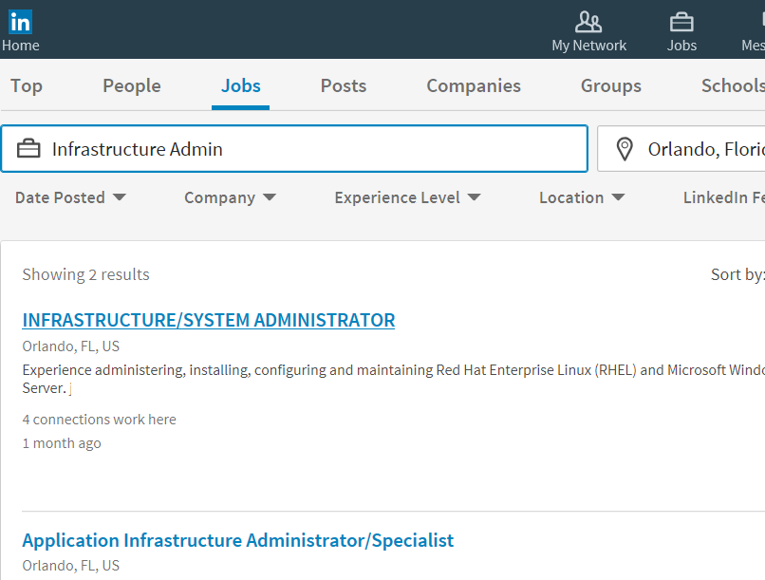

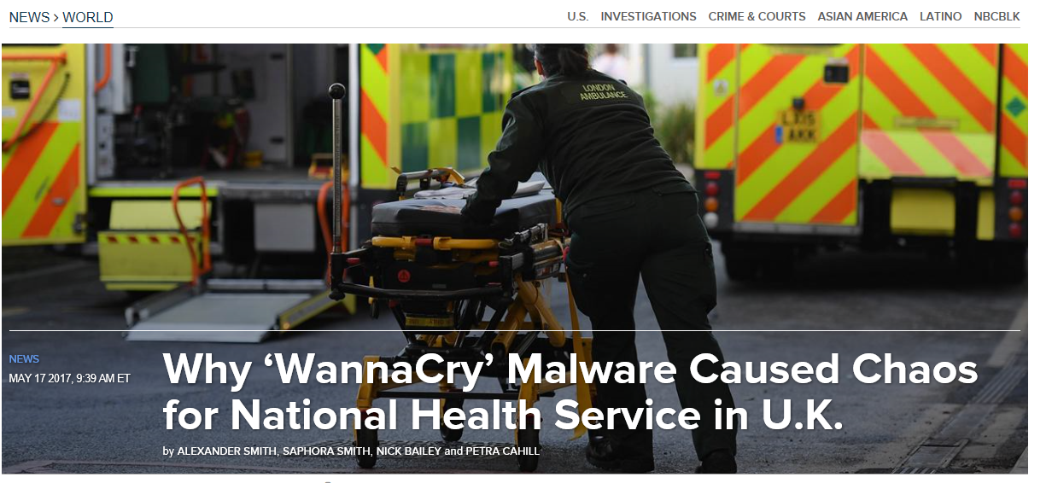
The impact of an outage on your digital business
Business continuity and data protection are critical
Impact to
your business
Impact to
your brand
Impact to
your IT career

Slide 4

What you can do to ensure continuity
A good business continuity strategy solves for three important areas:
Primary site
Primary site
Secondary site
Original
Backup
High availability
Disaster recovery
Backup
When your applications or infrastructure have failure, run a second instance in the primary site
When your primary site has failures, run your applications in secondary site
When your data is corrupted, deleted, or lost you can restore it

Slide 5
How Microsoft Azure can help
Primary site
Primary site
Secondary site
Original
Backup
High availability
Disaster recovery
Backup
Azure Site Recovery
Azure Backup
A simple and compliant service for orchestrating your disaster recovery plan
Simple and reliable cloud-integrated backup as a service
Simplified set up
Cost-effective services
Increased compliance

Slide 6
Azure Backup

Slide 7




Azure: a single solution across the entire deployment
SQL
Azure resources
Hybrid resources
Simple
Secure
Cost-effective

Slide 8


Architecture matters
Scale-up
Within the enterprise
Azure Backup Service
Data plane
No infrastructure
Backup
extension
Recovery Point Management
Data pruning
Enterprise scale
Storage Management
Data packing
Extensible
Backup
extension
Scale-out
Across customers
Authentication
Policy management
Monitoring
&
Reporting
Central management
Access control
Management plane

Slide 9
Azure VM Backup
Demo

Slide 10

Linux application-consistent backup
Open support platform
Back up any Linux app
1
Configure backup
Application consistency
3
> _pre-script
4
VM snapshot
2
Start backup
5
> _post-script
6
Incremental backup saved in vault

Slide 11
Protection of Azure Linux workloads
Demo

Slide 12
Azure VM backup capabilities
Features
Configurations
Management
Managed disks
Application consistent
No need to shutdown
Incremental backup
Long-term retention
Restore as VM or VHD
Item-level recovery
Encrypted VM backup
SSE
Windows and Linux
Premium disks
Load balancer
Multi NIC
Reserved IP
ASM and ARM
Built-in policies
Job monitoring
Email alerts
Role-based access
Powershell and CLI
OMS monitoring
PowerBI reports

Slide 13
Azure Workload Backup
Demo

Slide 14
Azure Backup roadmap
Azure CLI for Linux
(public preview October)
Windows Server System State Backup
(GA November)
Upgrade of Backup Vault (GA November)
(ASM) to Recovery Services Vault (ARM)
(GA November)
Backup of large-disk VMs (public preview December)
Enable backup during VM creation (public preview December)
Backup of SQL in IaaS (preview)
Backup for Azure Files (preview)
Backup of encrypted VMs without requiring KEK
(H1 of 2018)
Backup of VMs with
storage ACLs
(H1 of 2018)
Resource move across RG
and subscription
(H1 of 2018)
Removal of vault limits
(H1 of 2018)
Questions about these features?
Email: Askazurebackupteam@microsoft.com

Slide 15
Disaster recovery between Azure regions

Slide 16

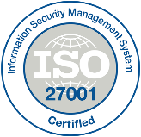










Disaster recovery for compliance and security
ISO 27018
ISO 27001
ITAR
Cloud Controls Matrix
Disaster recovery in the cloud helps you stay compliant and secure
Azure offers the broadest range of compliance certifications
FedRAMP
DISA Level 2
CJIS
HIPAA/HITECH
Azure works with federal and global organizations to set the bar for compliance and security best practices
EU Safe Harbor
European Union
Model Clauses
United Kingdom
G-Cloud
China Multi-Layer
Protection Scheme
Notes:
Trusted
Compliance and trust is not an afterthought at Microsoft.
We are leaders in this space, and help set standards for global and federal organizations around the world.
Microsoft has been talking about trust in the cloud for a while and will continue to do so.
This is only a sampling of our compliance certifications, but we run the gamut.
Azure’s strengths are around security, privacy, and transparency around how we run the cloud.

Slide 17
Disaster recovery between Azure regions
Perform DR drills with no production impact
Decide when you want to failover applications
42
Set up disaster recovery from the virtual machine experience
Azure regions and counting
The only cloud provider allowing DR to be performed between cloud regions
Notes:
Trusted
Azure is continuing expand its infrastructure footprint around the globe.
In fact, Microsoft is the first cloud provider to put data centers in South Africa.
Right now, we’re at 42 Azure regions—which is more than AWS and Google combined.
The approach Azure takes is different as it is important for enterprise customers to have data in region, close to employees, close to customers as well as have unique data handling capabilities.

Slide 18
Replicate Azure VMs with Azure Site Recovery
No disaster recovery infrastructure
WEB TIER
WEB TIER
Automated protection and replication
Best-in-class recovery point objective and recovery time objective
APP TIER
APP TIER
Orchestrated recovery plans for application-aware recovery
DB TIER
DB TIER
MySQL
MySQL
Failback support
HYPERVISOR
HYPERVISOR
Azure
Azure
Public cloud (North Europe)
Public cloud (West Europe)

Slide 19
Disaster recovery between Azure regions
Demo

Slide 20
Azure-to-Azure DR feature roadmap
 | Features | Configuration | Management
Public preview | Application and crash-consistent replication | Windows (2008 R2, 2012, 2012 R2, 2016) Linux (RHEL, Cent OS, SUSE, OEL , Ubuntu) | Built-in policies
 | No-impact DR drill | Classic and resource manager virtual machines | Job monitoring
 | Orchestrated recovery plans for application DR | Standard and premium storage | Events and monitoring
 | Failback support | Storage spaces
General availability | Multi-VM consistency (December ‘17) | Debian (July ‘17) Support for large disks (4Tb) (August ‘17) VMs on managed disk (January ‘18) | Advanced monitoring PowerShell
Notes:
Land the OS Coverage message strongly. Now with ASR our goal is to enable App aware DR and an App consists of multiple VMs and require consistency across multiple VMs to ensure App comes up successfully on failover – we are happy to announce support for multi-VM consistency for the same.

Slide 21
Networking in Azure

Slide 22
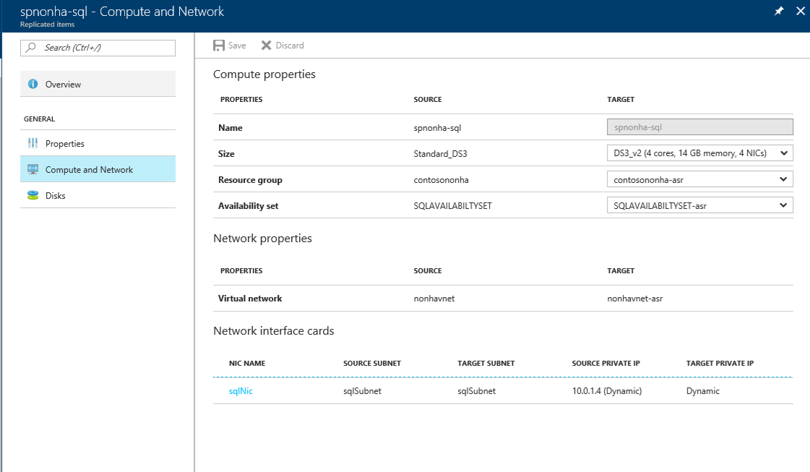
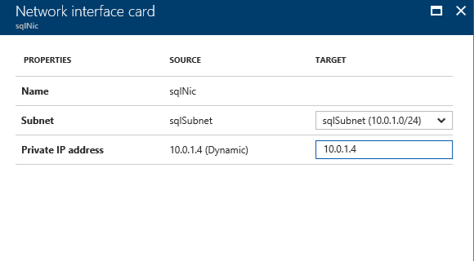
Networking
Retain IP or change IP

Slide 23
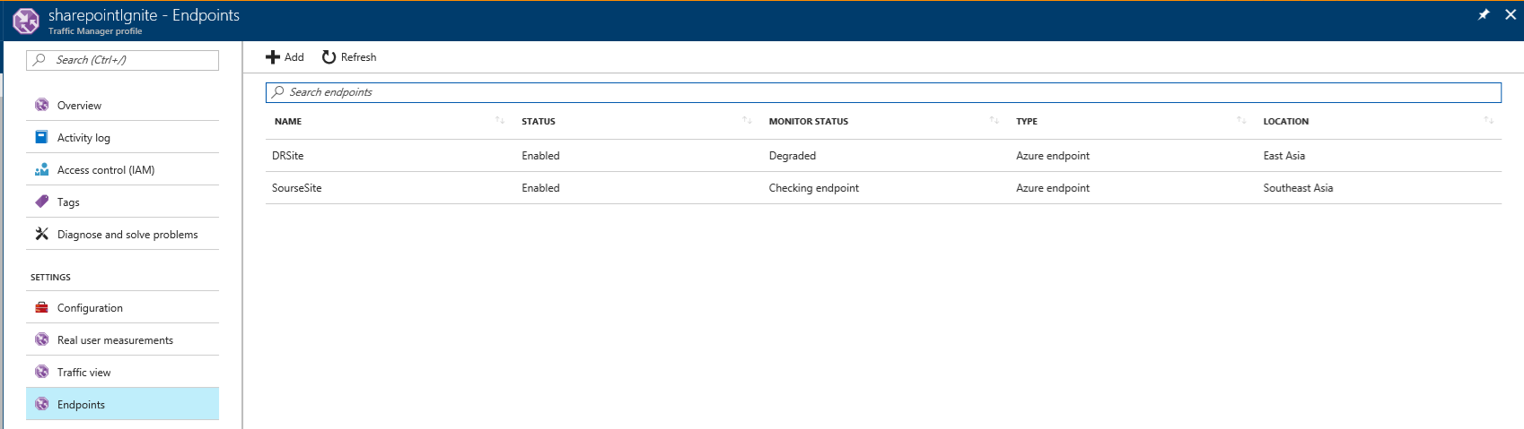
Networking
Retain IP or change IP
Client connectivity

Slide 24
Networking
Retain IP or change IP
Client connectivity
2
On-premises connectivity
Azure source region
Azure target region
1
3
On-premises datacenter

Slide 25
Enable disaster recovery for Azure IaaS virtual machines
Demo

Slide 26
Architecture matters
Scale-up
Within the enterprise
Azure Backup Service
Data plane
No infrastructure
Backup
extension
Recovery point management
Data pruning
Enterprise scale
Storage management
Data packing
Extensible
Backup
extension
Scale-out
Across customers
Authentication
Policy
management
Monitoring
&
reporting
Central management
Access control
Management plane

Slide 27

SharePoint – non HA
VNET
Public IP
Multi-tiered with Availability Set
LB
Load balancers
Availability Set
WEB1
WEB2
Public IP connectivity
ILB
LB
AD1
S1
SQL Always On
Availability Set
APP1
APP2
AD2
ILB
Availability Set
S2
Availability Set
SQL1
SQLW
SQL2

Slide 28
Application-aware recovery
Enable protection
VNET
Public IP
VNET
Public IP
LB
Failover
LB
Availability Set
Availability Set
WEB1
WEB2
WEB1
WEB2
ILB
LB
LB
ILB
AD1
S1
S1Cache
S1ASR
AD-DR
Availability Set
Availability Set
APP1
APP2
AD2
APP1
APP2
ILB
ILB
Availability Set
S2
S2Cache
S2ASR
Availability Set
Availability Set
Availability Set
SQL1
SQLW
SQL2
SQL replication
SQL1
SQLW
SQL2

Slide 29
Application-aware DR using ASR replication
Demo

Slide 30

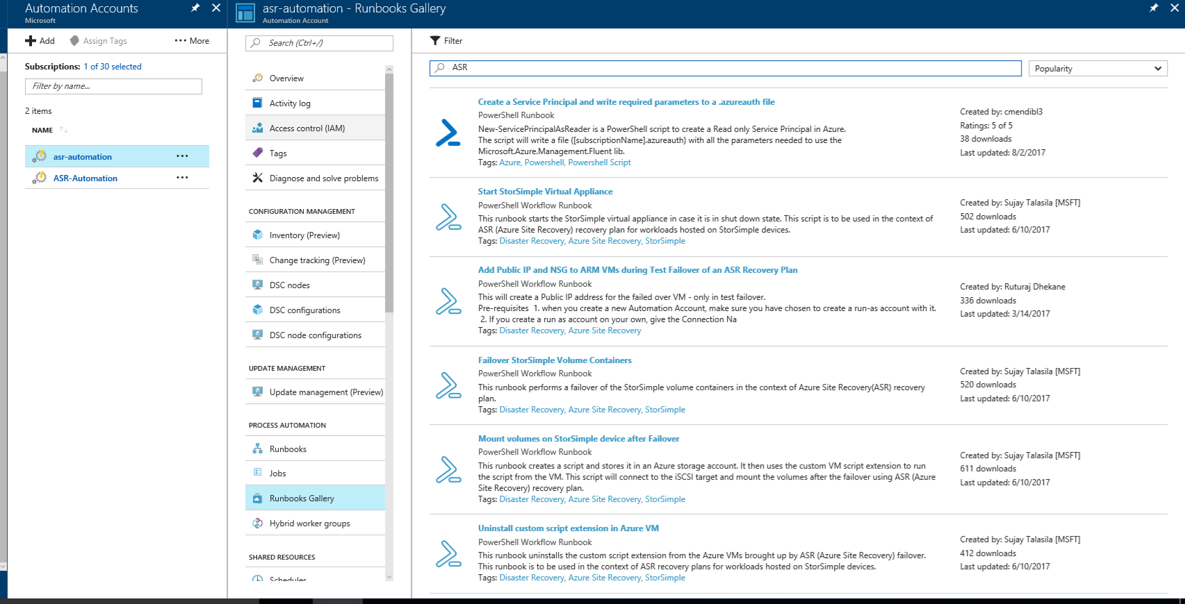
Rich automation using Azure Automation
Notes:
Add Azure automation runbooks to recovery plans

Slide 31
Pricing
  ASR licensing
  Network egress pricing
    Directly proportional to the amount of data churn on the disks
  Additional storage costs on the recovery site
    Typically similar to primary storage cost
  Compute – pay as you go
    Some VMs – like AD etc. may always be running
    Other VMs – ASR will automatically create and start on failover
Notes:
Stress on the Cost effective DR as no need for additional DC also it comes built-in with Azure Platform so no need to buy, run and manage additional software components to enable DR.

Slide 32
Session objectives and takeaways
Differentiated Azure approach for business continuity
Meet your BCDR compliance needs in Azure
Simple configuration of backup and disaster recovery
Reduce cost by leveraging Backup and Site Recovery

Slide 33
Azure Backup and Site Recovery resources
Azure Backup
Azure Backup’s cloud-first approach | https://azure.microsoft.com/blog/azure-backup-cloud-first-architecture/
Azure Backup blogs | http://blog.azure.com/tag/azure-backup/
Azure Backup videos | https://channel9.msdn.com/Series/Azure-Backup
Azure Backup landing page | http://azure.microsoft.com/en-us/services/backup/
Feedback (UserVoice) | https://feedback.azure.com/forums/258995-azure-backup-and-scdpm/
Azure Site Recovery
A10 Azure Site Recovery content | https://aka.ms/a10asr
Site Recovery documentation | https://aka.ms/siterecovery_documentation
Site Recovery blogs | https://aka.ms/siterecovery_blogs
Site Recovery how-to videos | https://aka.ms/asrvideos
Support forum | https://aka.ms/asrforum
Feedback (user voice) | https://aka.ms/ASRuservoice

